Slide 1
Phase 4: Missile Defense
Charlie
Lt David Crow
Lt Savannah Hyde
Lt Ahmed King

Slide 2
Group Steps to Complete Deliverable
Enumerate steps taken by group to accomplish deliverable
David: allowed for multiple red and blue missiles; computed intersection points/times
Savannah: extensively tested system; conducted performance analysis
Ahmed: fired blue missiles and detonated at expected intersection points; detonated intercepted red missiles
Issues
Math is hard
MotionAlgorithm expects an (x, y, 0) point
Intersections are heavily time-dependent
Notes:
Enumerate steps taken by group to accomplish deliverable
Who did what?
What issues arose based on preliminary plan?

Slide 3
Design Decisions
Software quality attributes
Scalability: Make no assumptions on the number of missiles the system will handle
Testability: Missiles can fire randomly or according to user input
Design patterns
No new patterns this phase
Aggregate and strategy patterns already in use
Notes:
Justify your Software Quality Attributes
Convince me why your design decisions are fundamentally sound from a Software Engineering perspective.
Pros / Cons of decisions
There is no “perfect” answer, every decision is a tradeoff between one or more competing attributes
Which Software Quality Attributes did you prioritize first?
What Patterns did your group employ? Why?

Slide 4
Lessons Learned
What worked?
Accommodating multiple, randomized red missiles
Managing and firing red missiles
The engine
If you could send a message back through time, what would you tell your group?
Redo the motion algorithm
Plan for easily-tested functionality from the start
Notes:
What worked?
What did not?
If you could send a message back through time, what would you tell your group?

Slide 5
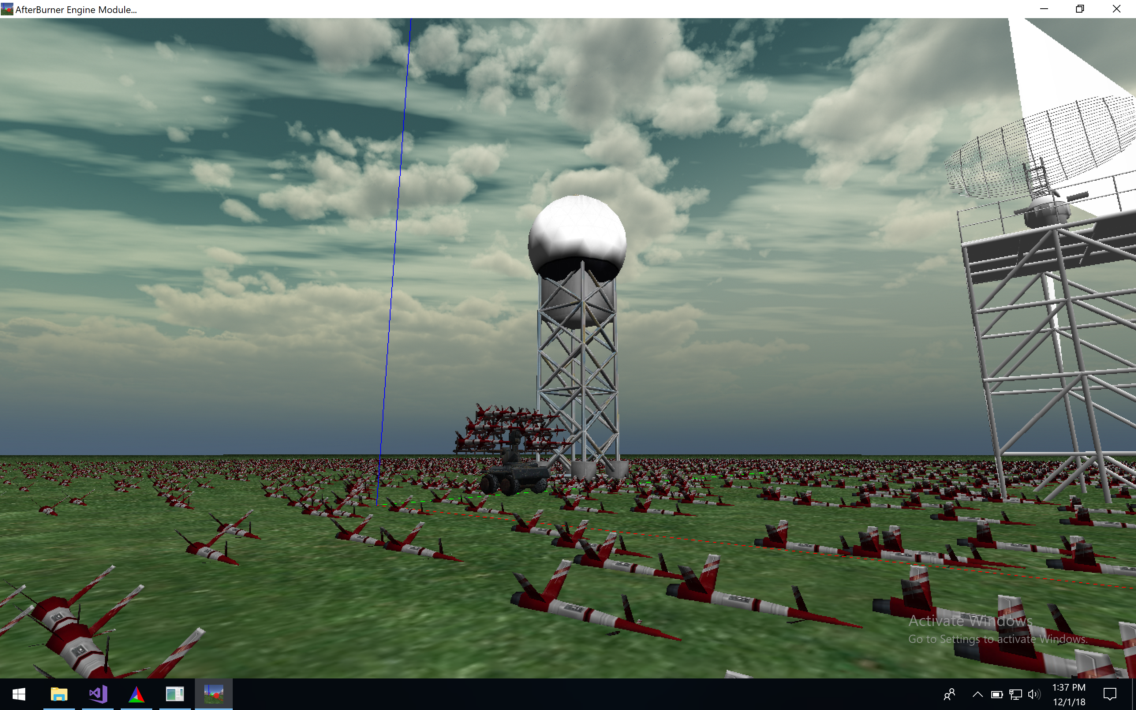
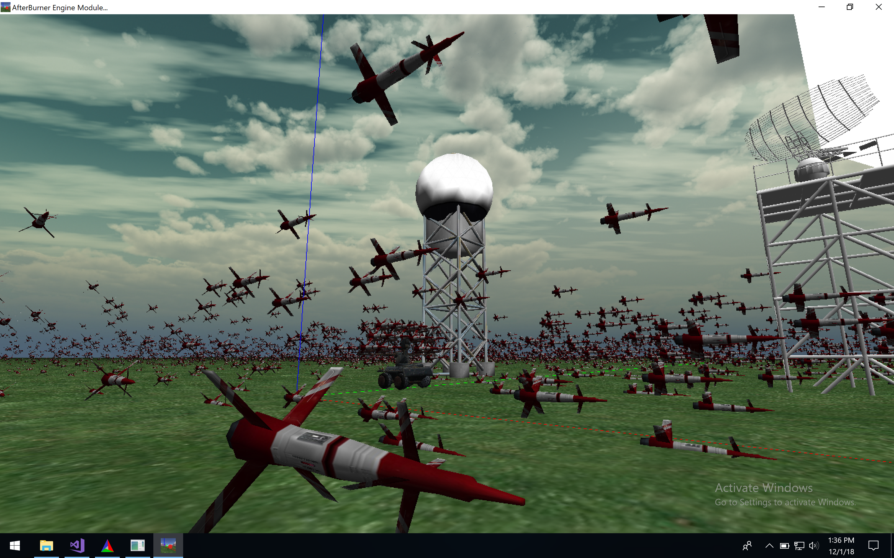
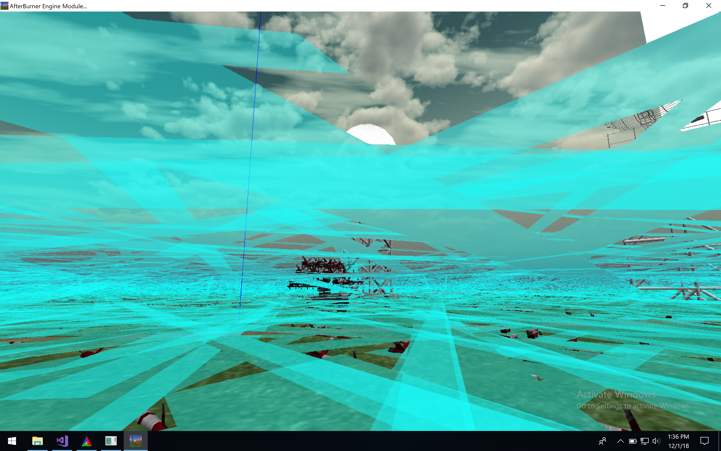
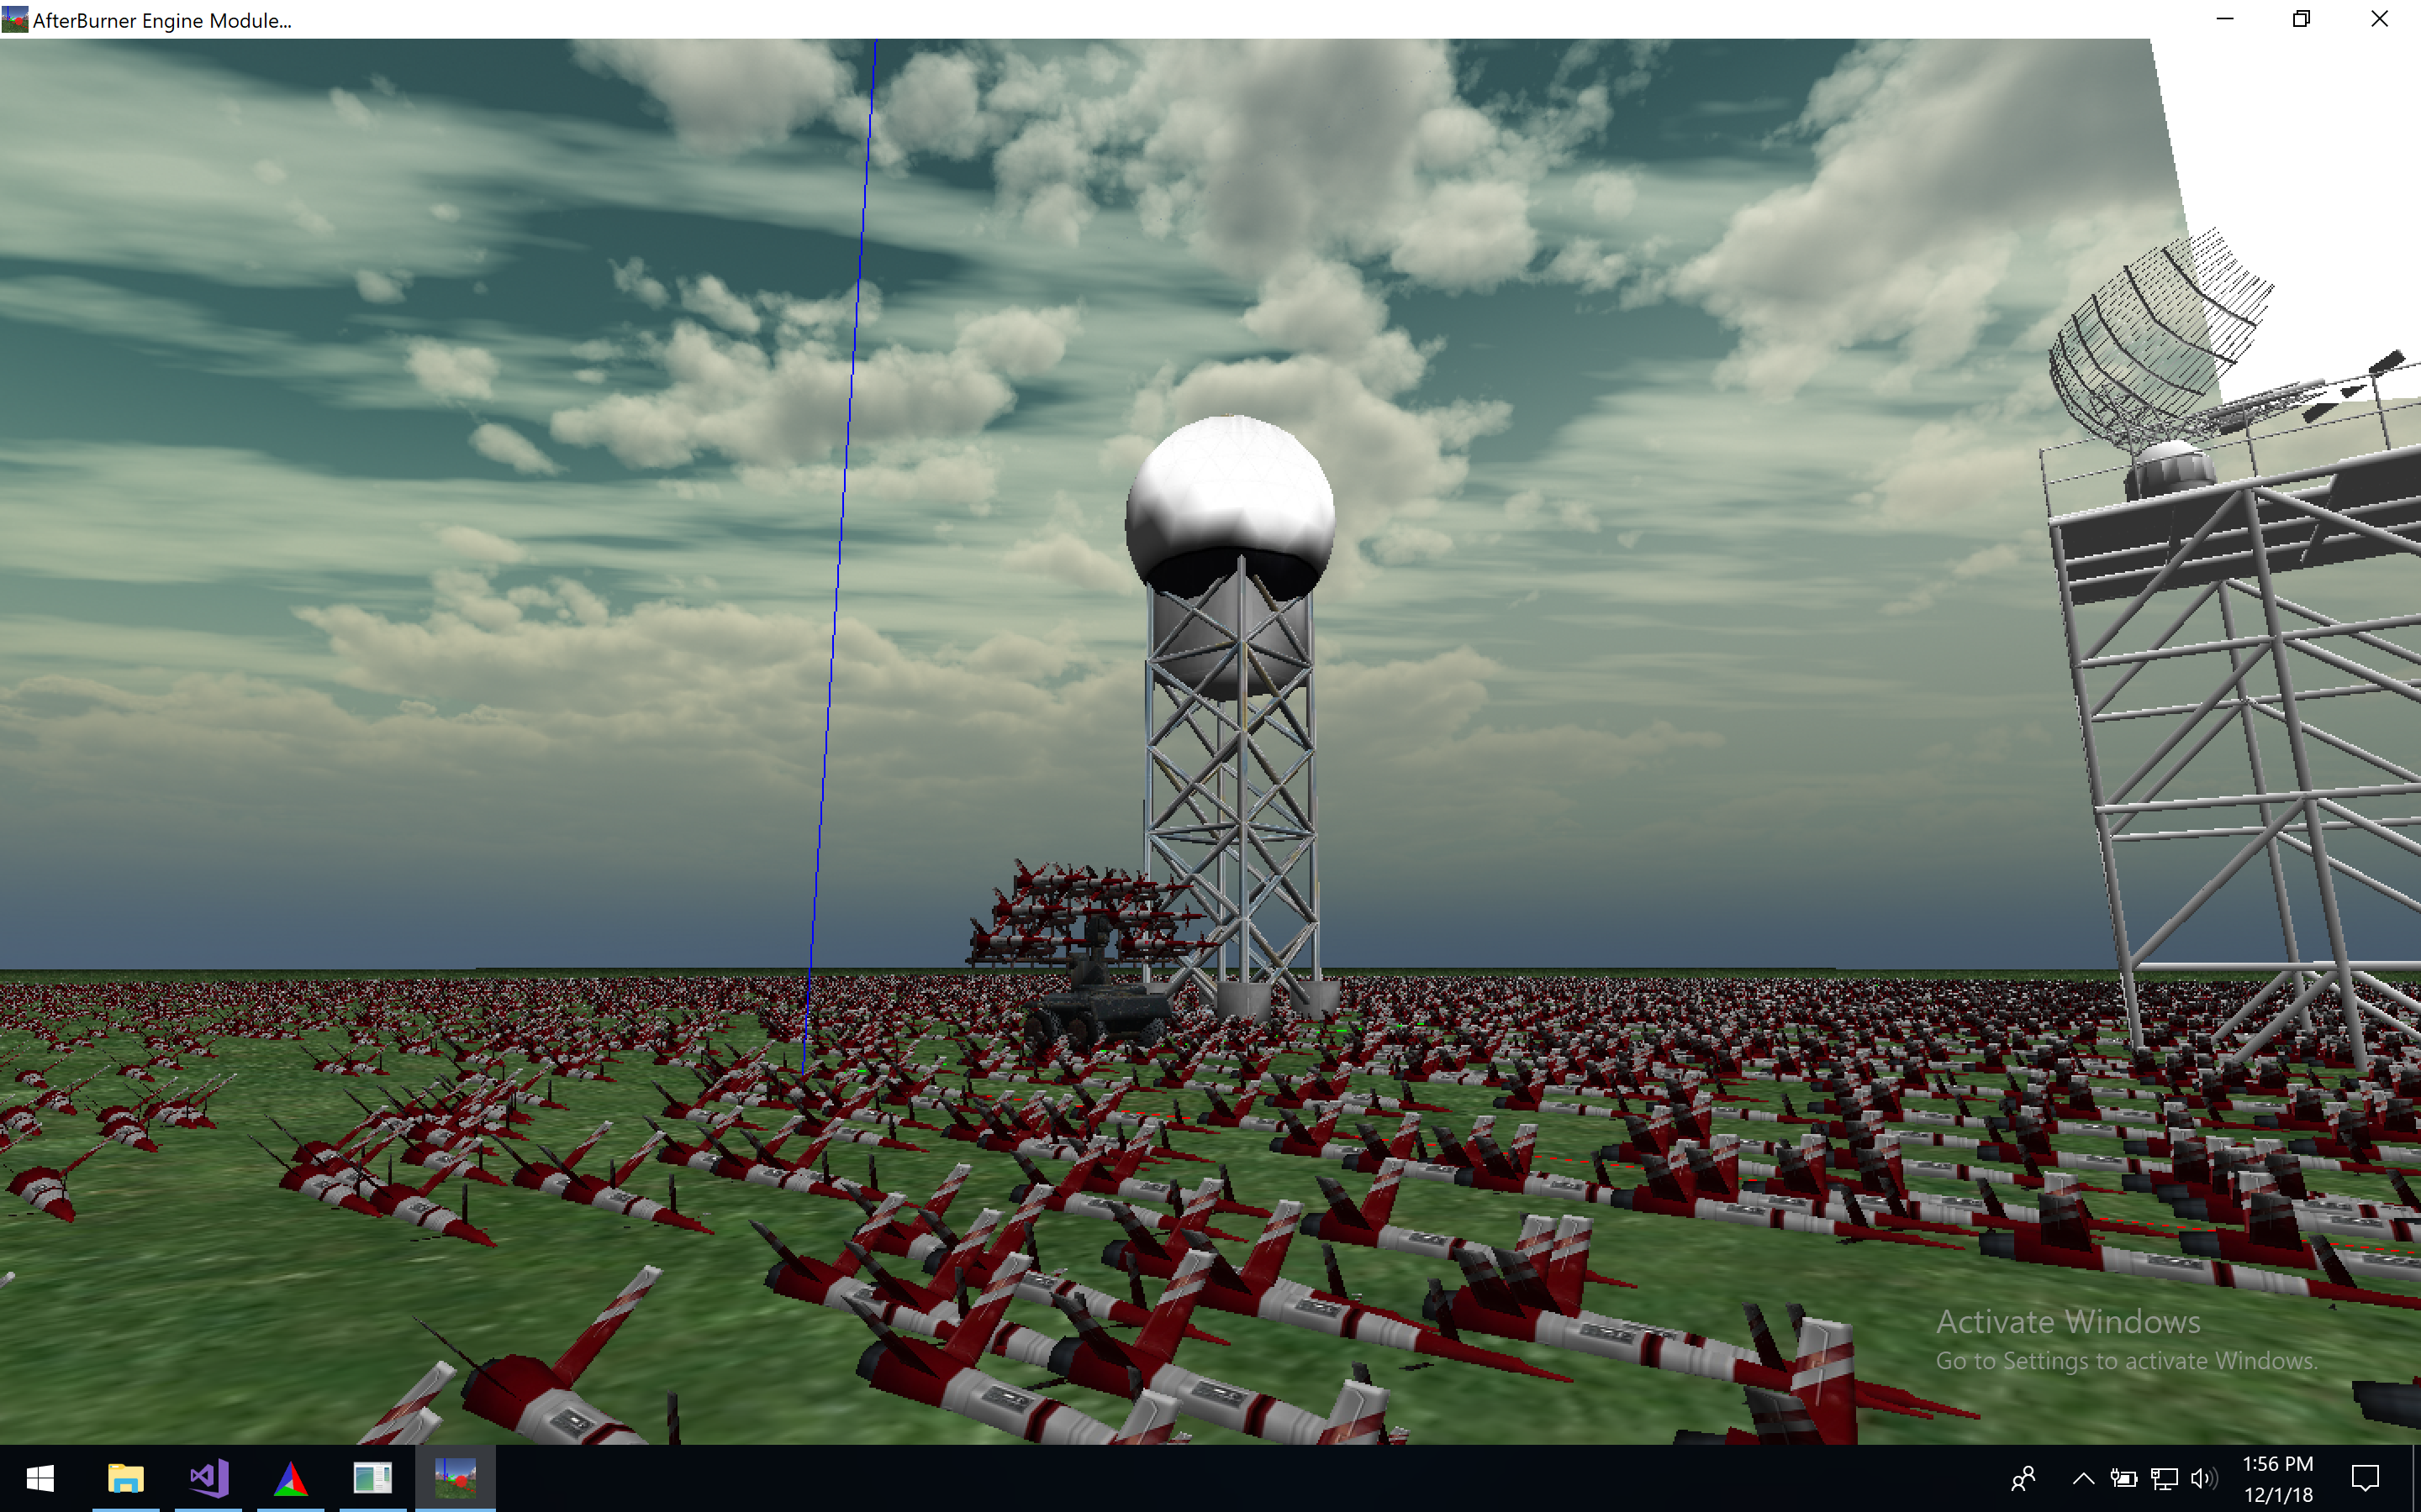
Engine Performance Analysis
Notes:
Convince me why your system works
When does it fail?
Provide Quantitative evidence
When does it work?
Provide Quantitative evidence

Slide 6
System Testing
108 Test Cases
Manual Testing
Smaller set of test cases
Minor bugs
Mouse movement/key presses
Parameters
Realistic, Scoped, and Reasonable
Test Parameters
Rotations Per Second | Wedge Angle | Scan Range (m) | Number of Missiles | Time of Red Interval
{6,12} | {20,40} | {50,500,1000} | {1,2,4} | {2,4,6}
Notes:
Convince me why your system works
When does it fail?
Provide Quantitative evidence
When does it work?
Provide Quantitative evidence

Slide 7
Defense System Performance Analysis
System Performance
Red Missiles Fired: 252
Red Missiles Destroyed: 120
System Accuracy: 49.60%
System Limitations
Occasionally inconsistent
Accuracy dependent upon missile count
Number of Red Missiles | Average System Success Rate
1 | 77.78%
2 | 48.61%
4 | 43.06%
Notes:
Convince me why your system works
When does it fail?
Provide Quantitative evidence
When does it work?
Provide Quantitative evidence

Slide 8
Team Hours and Morale
Lt David Crow: medium morale
2 hours: expanding system to accommodate multiple red/blue missiles
5 hours: adequately computing intersection points
3 hours: (helping Ahmed with) firing blue missiles
Lt Savannah Hyde: high morale
3 hours: Creating script for testing… then scratching it
2 hours: Manually testing
Lt Ahmed King: high morale
6 hours: firing blue missiles to a given point
1 hour: detonating red/blue missiles; testing appropriate intersection values
Notes:
Capt Student (32 hrs)
Hrs Breakdown
12 hrs Brainstorming/Researching (gnuplot plot design, early prototypes)
5 hrs Implementing Dish Rotation
15 hrs Supporting Data Structure Implementation/Debugging
Biggest Time sinks
Current Morale Status: High / Medium / Low morale

Slide 9
Why Buy From Us?
The economical choice
Lowest price technically acceptable
Useful in small, nonstrategic locations
Notes:
Capt Student (32 hrs)
Hrs Breakdown
12 hrs Brainstorming/Researching (gnuplot plot design, early prototypes)
5 hrs Implementing Dish Rotation
15 hrs Supporting Data Structure Implementation/Debugging
Biggest Time sinks
Current Morale Status: High / Medium / Low morale

Slide 10
Questions?

